Slide 1
PROJECT PRESENTATION
User-Centric Sentiment Forecasting
DEEP LEARNING PROJECT ; MSC DS
ARUNI SAXENA
PAARTH PATEL
ANANDITA SAOLAPURKAR
RISHI BARAPATRE

Slide 2
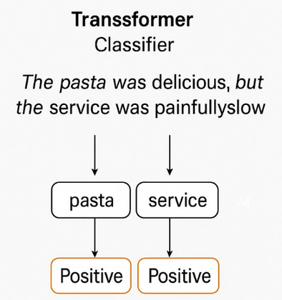


Problem Formulation
1
Problem Statement
Understanding the evolution of user sentiment over time
Challenges
Unreliable Ground Truth
Sparse User Data
Irregular Timestamps
hotel - 1
Sentiment Score
Only 5 reviews given
throughout the time
t1
t2
t3
t4
Irreregular Time Stamps

Slide 3

End-to-end solution pipeline
2
Initial Data Processing
Hybrid GNN for ABSA
Labelled with ABSA
scores -: The dataset has also been enriched with emotion annotations to capture what they talk (aspects), what they
feel about it (sentiment and emotion scores).
KMeans Clustering
Leveraging cluster’s review history to predict sentiment of user
Clustered Data at irregular timestamps- Time aware attention model
Unlabelled Yelp time series reviews
User centric Sentiment Forecasting
Added psycholinguistic features
Dimensionality Reduction for Latent Representation

Slide 4
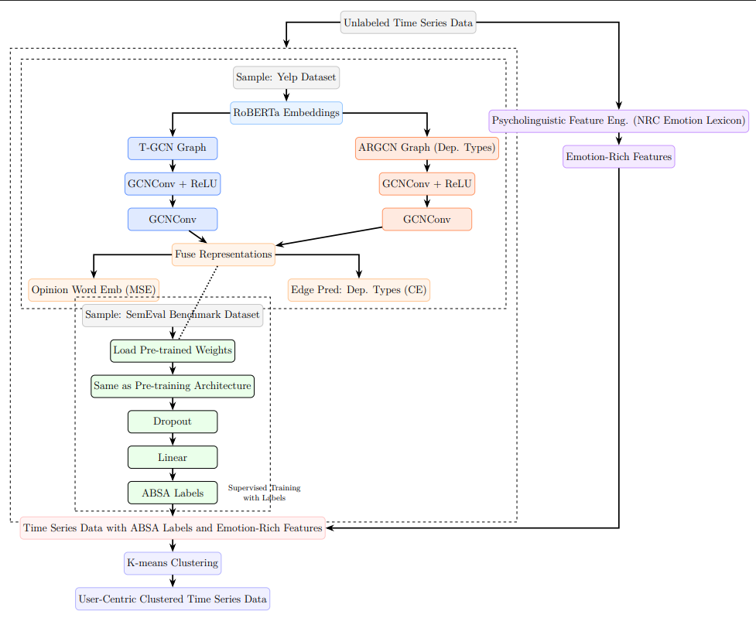
3
Model Architecture

Slide 5
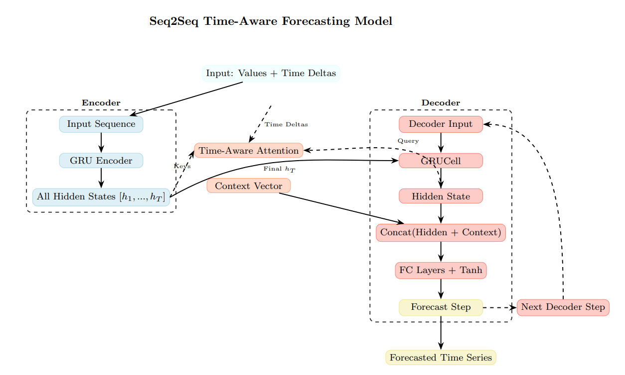
Model Architecture
3

Slide 6
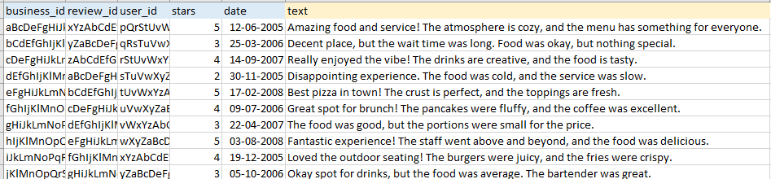
Training data
4
Training data comprises user reviews from 2015 to 2018
These have been made rich with nrc lexicon as mentioned before
They have been used to train the Time-Aware Sentiment Forecasting model

Slide 7
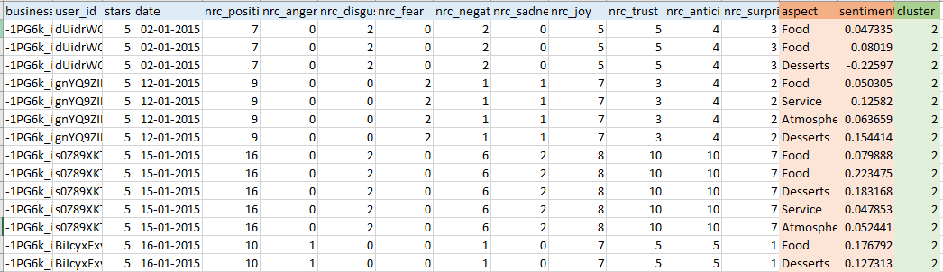
Training data
4
Training data comprises user reviews from 2015 to 2018
These have been made rich with nrc lexicon as mentioned before
They have been used to train the Time-Aware Sentiment Forecasting model

Slide 8
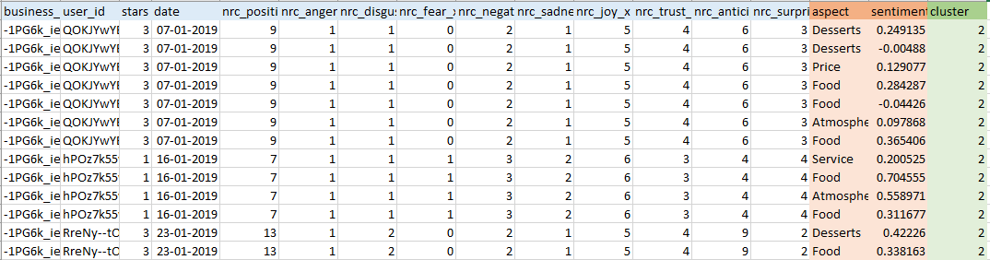
Test data
5
Test data comprises user reviews from January to December 2019.
Used to evaluate the performance of our trained forecasting model.

Slide 9
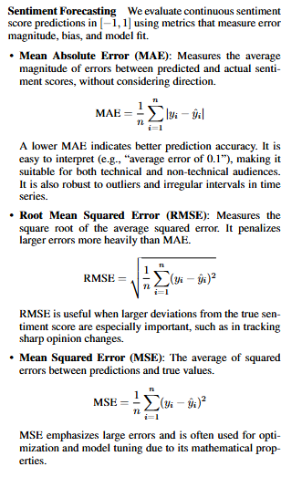
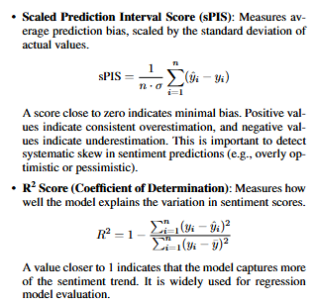
Evaluation metrics
5

Slide 10
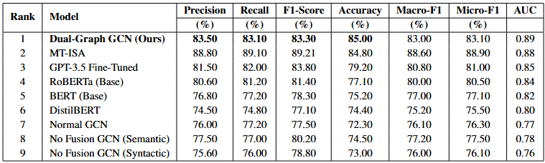
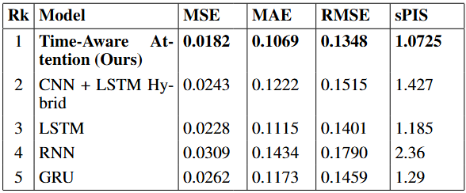
Leaderboard table
6

Slide 11
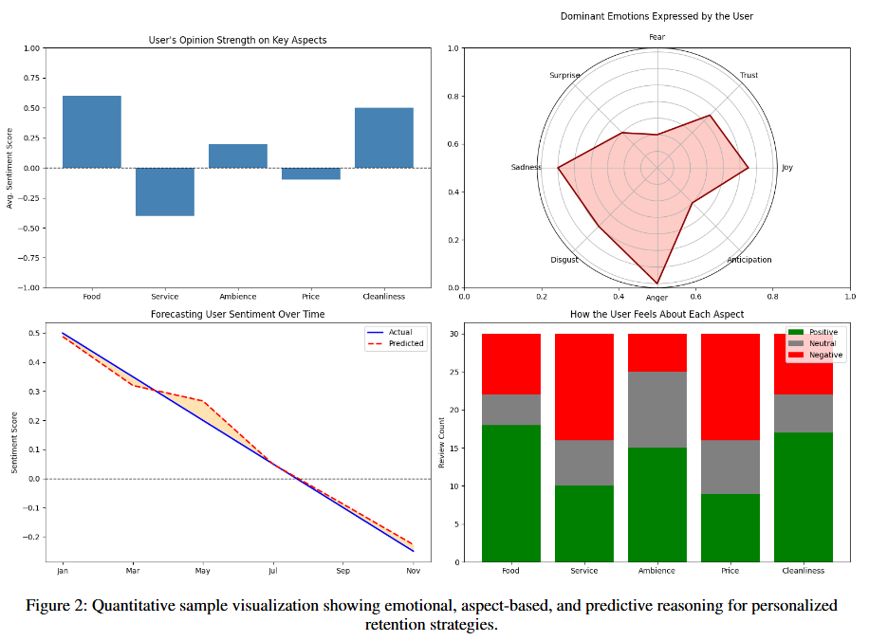
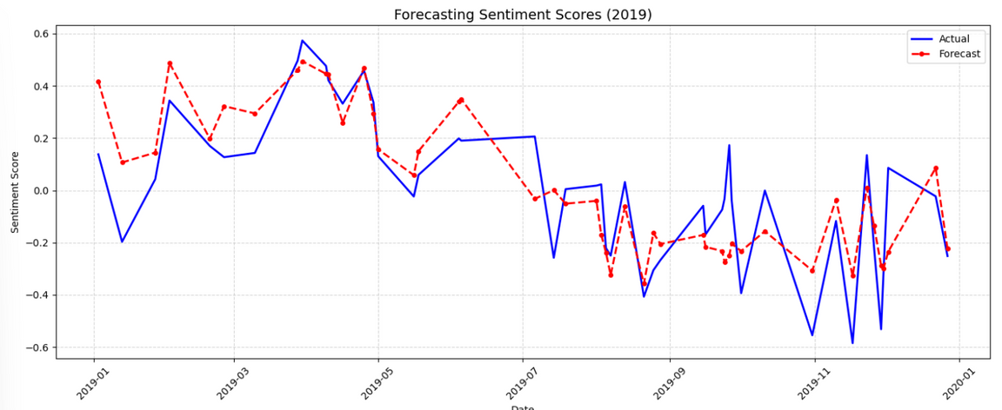
Additional result analysis
7
Quantitative sample visualization showing emotional, aspect-based, and predictive reasoning for personalized retention strategies.
Our analysis clearly identifies key areas driving positive (e.g., Food, Cleanliness) and negative (e.g., Service) sentiment.
This granular insight allows businesses to focus resources on improving specific pain points which can be addressed to improve customer satisfaction.

